Slide 1

Project Progress
IT 4004
FIND A SOLUTION TO INCREASE THE EFFICIENCY OF SOLAR CELLS FOR SUSTAINABLE POWER GENERATION AND REDUCE THE CONSUMPTION OF FOREIGN FOSSIL FUELS FOR POWER GENERATION

Slide 2
Scope
Efficiency of the power generation using solar energy is quite less than the other modes of electricity generation. Hence increasing the efficiency of the power generation of Solar Cell is greatly beneficial.
If we can increase solar power generation efficiently, considering the cost of Solar Panel, this will help to reduce required capital and resource wasting while installing a solar power plant.

Slide 3
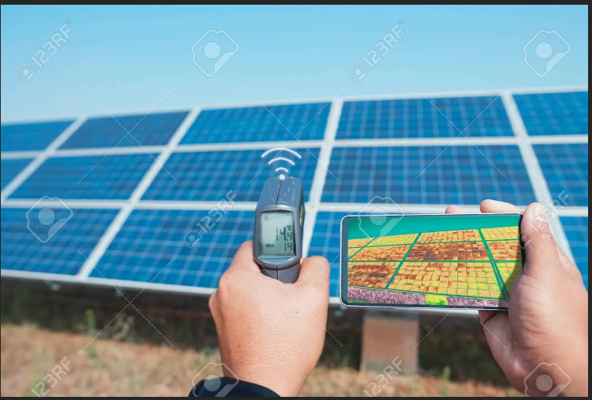
Objectives
Compare the results of this project that expect with the manufacturer’s specified operating temperature to conclude the impact on efficiency.
Find the best PV panels that suits to the temperature conditions in certain area.
Minimize the overuse of Solar Panels
Calculate the required solar panel quantity for a given power output by:
Panel size
Manufacturer Specified solar panel parameters
Power output at standard conditions
Area temperature

Slide 4
About the web app
Current Stage:
Visualize three datasets:
a climate dataset of the areas
Solar panel efficiency dataset
dataset of research findings about solar panel efficiencies in different climate conditions
Analyse each dataset
Next:
Compare & cross analyze
Estimate efficient Temperatures that can deliver maximum power output for a given Solar Panel
Calculate the cost & benefit
We expect to popularize the efficient use of solar panel systems which can be fulfilled customer requirements without wasting capital and resources

Slide 5
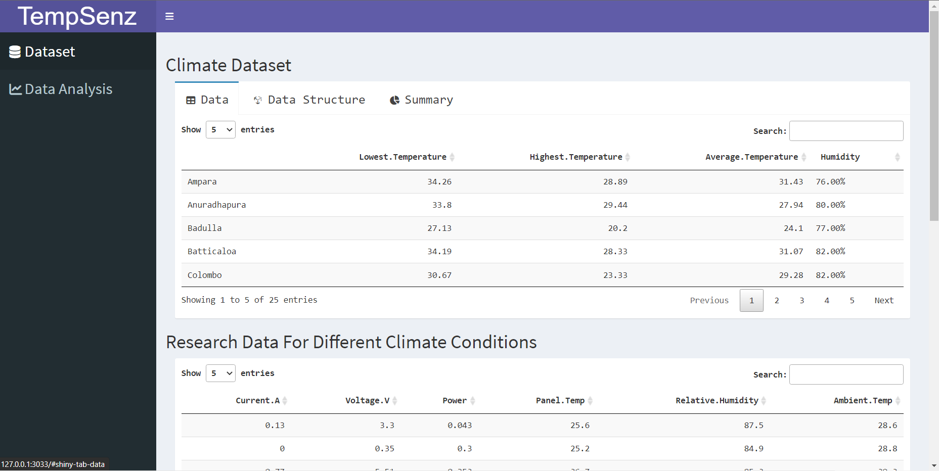
Datasets

Slide 6
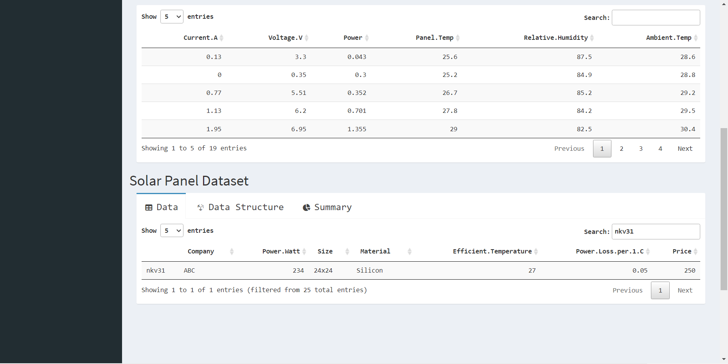

Slide 7
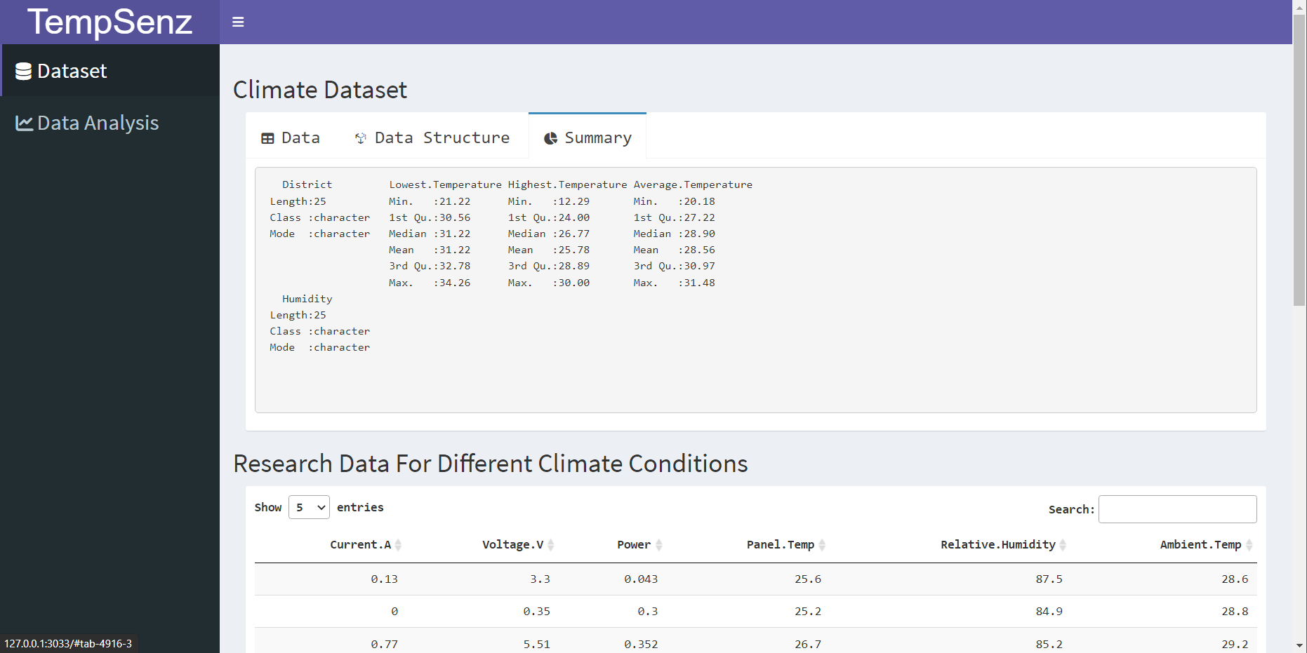
Dataset Summary

Slide 8
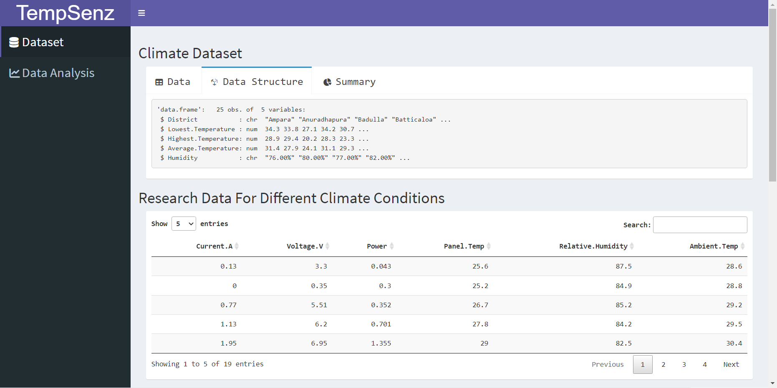
Data Structure of a Dataset

Slide 9
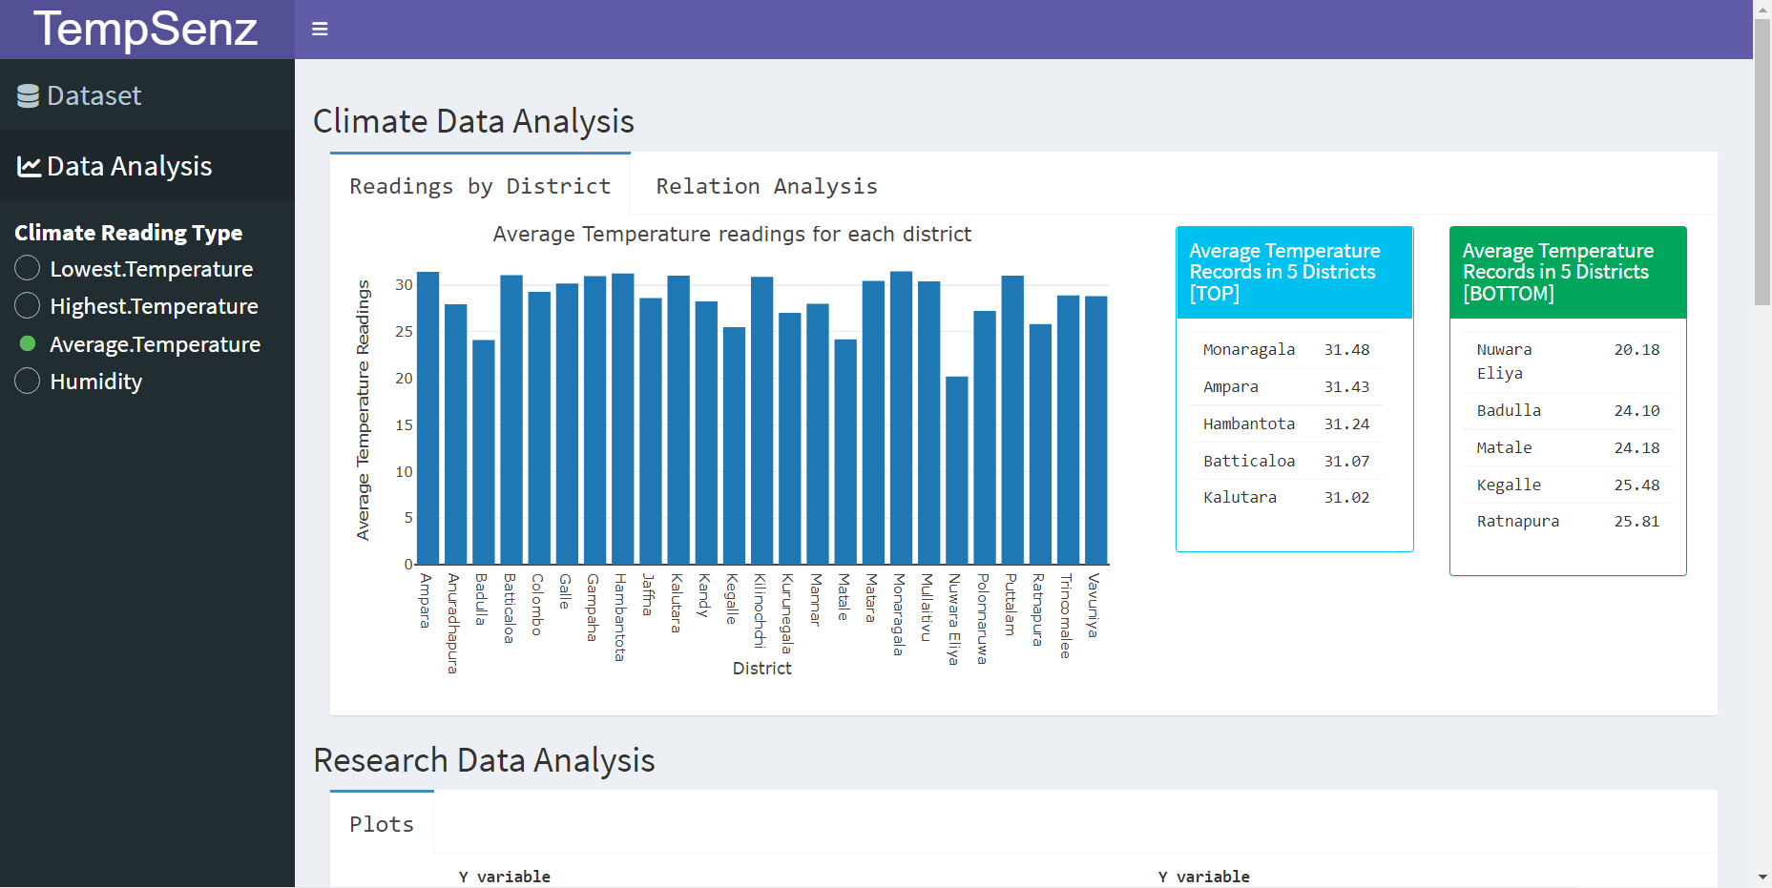
Climate Dataset
Presenting climate conditions of the districts of Sri Lanka, which is useful to find the exact climate conditions to select the best-fit location to install a solar panel system.

Slide 10
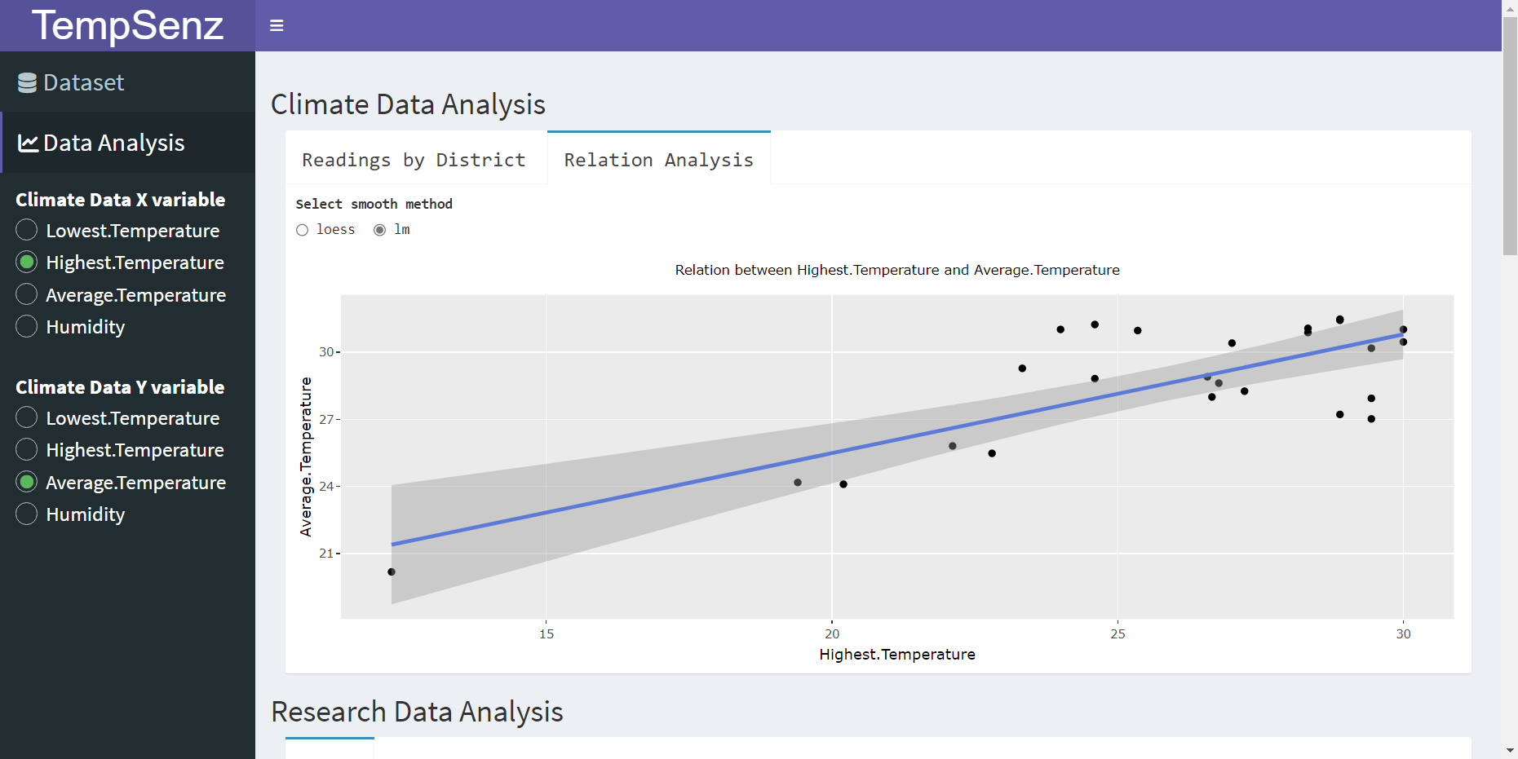

Slide 11
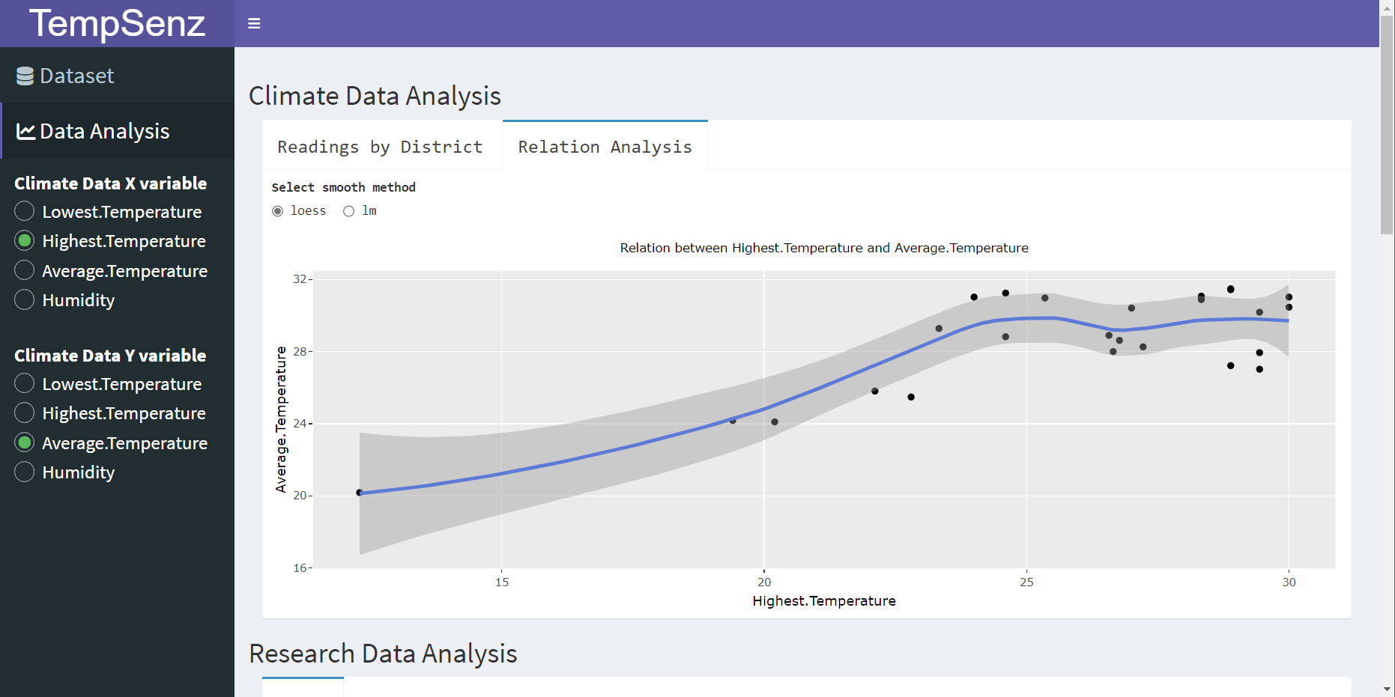

Slide 12
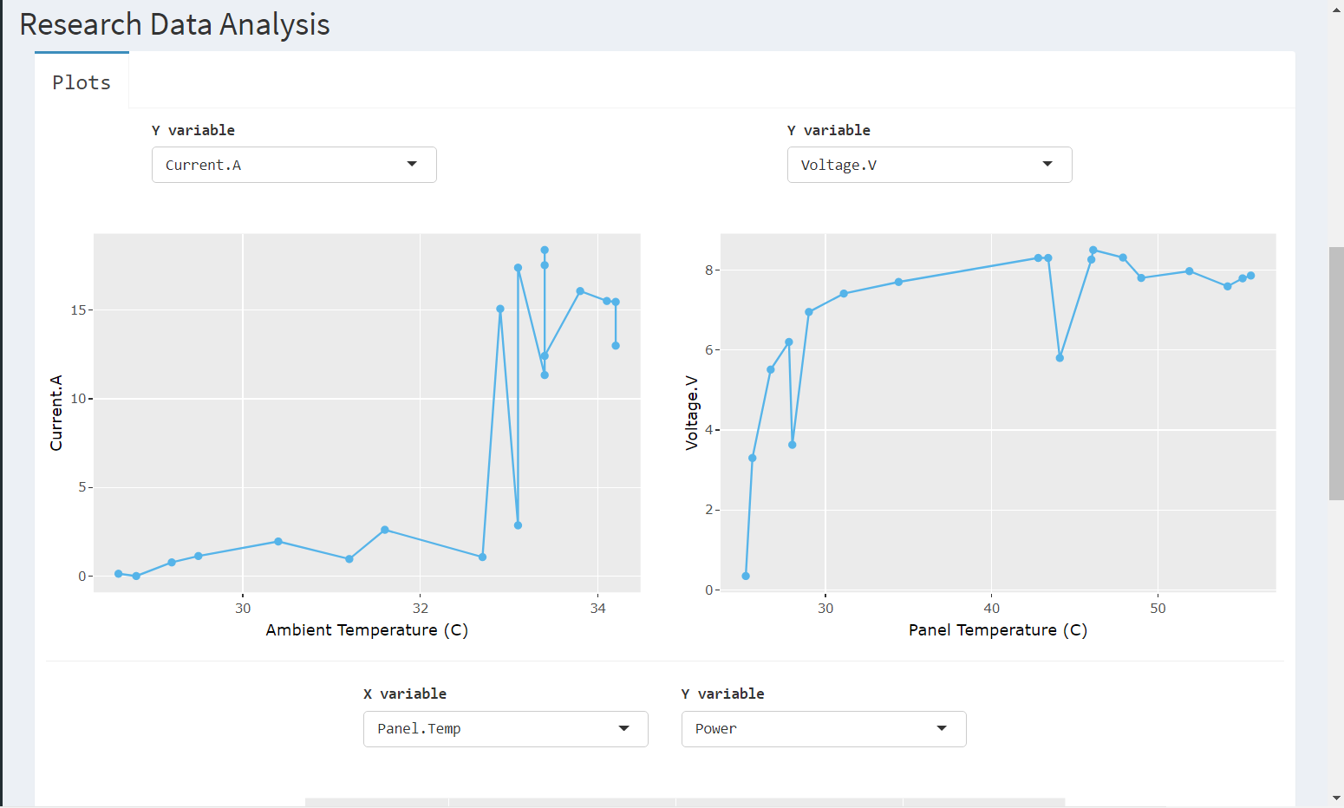
Drop down menu to select the options:
Current
Temperature
Voltage
Power
Efficiency

Slide 13
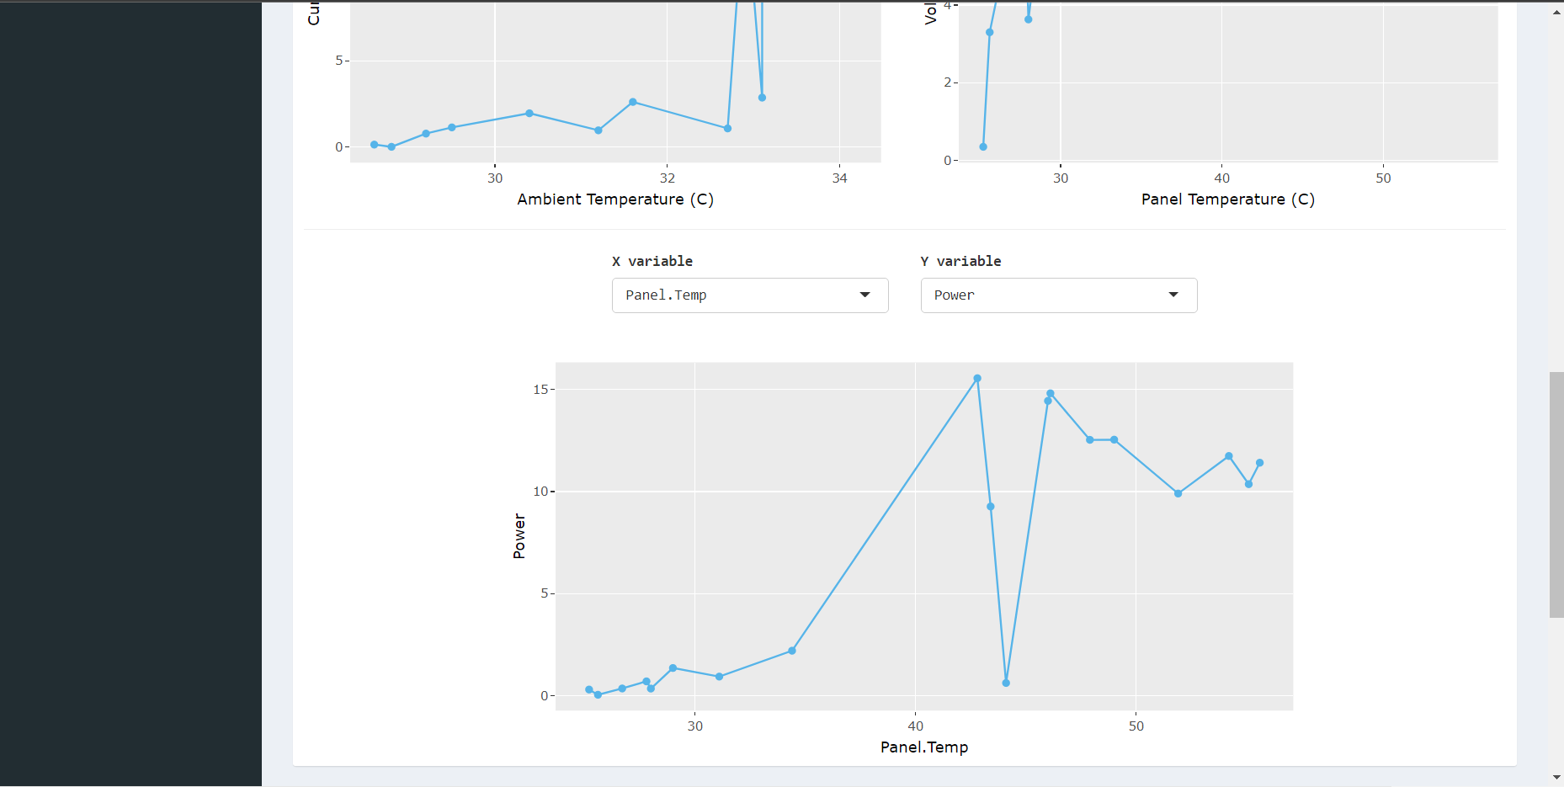

Slide 14
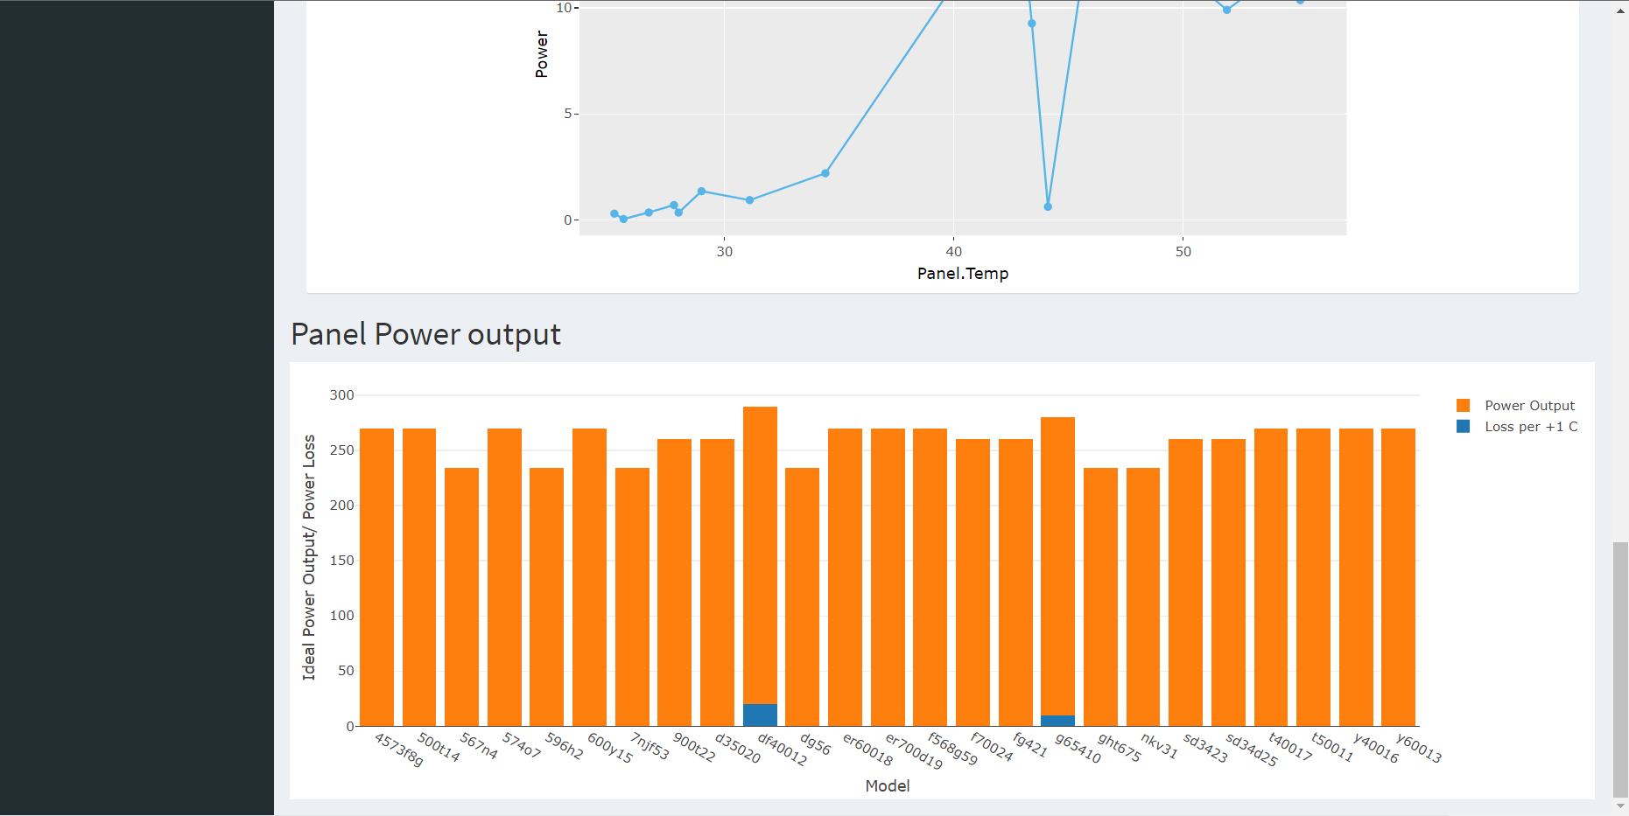
Panel power output data Vs the main Panel models

Slide 15
Further developments in the app
Hope to use MySQL databases rather than using CSV data files
Compare & cross analyze
Estimate efficient Temperatures that can deliver maximum power output for a given Solar Panel
We expect to popularize the efficient use of solar panel systems which can be fulfilled customer requirements without wasting capital and resources

Slide 16
Thank You

